Slide 1
DLD PROJECT
TITLE :
4 – BIT ARITHMETIC
LOGIC UNIT (ALU)

Slide 2
GROUP MEMBERS :
ABDUL BASIT (20K-0333)
YASIR JAMAL (20K-0158)
ANAS HASSAN (20K-1726)
MUHAMMAD WARZAN (20K-1649)

Slide 3
APPLICATION AND
MOTIVATION:
An Arithmetic and Logic Unit (ALU) is a digital circuit used to perform arithmetic and logic operations . It represents the fundamental building block of the Central Processing Unit (CPU) of a computer.
Since ALU is the most basic and fundamental part of the C.P.U , capable of performing all basic operations . So , it motivates us to design such project which is capable of executing such operations .

Slide 4
DIFFERENT MODULES OF PROJECT :
ADDITION (HARDWARE AND SOFTWARE )
SUBTRACTION (HARDWARE AND SOFTWARE )
COMPARATORS (HARDWARE AND SOFTWARE )
4. MULTIPLICATION (ONLY SOFTWARE )

Slide 5
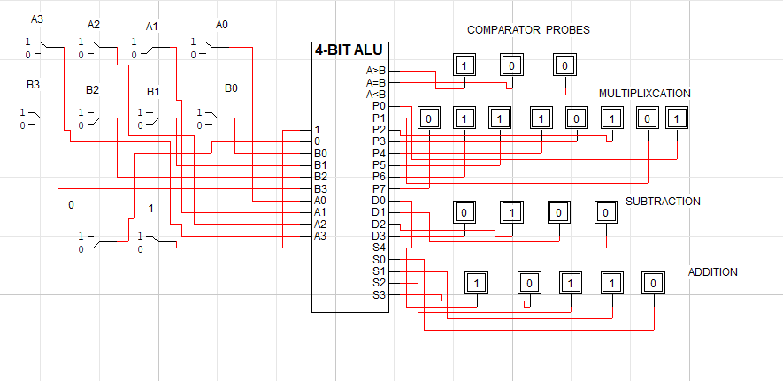
OUTPUT OF CIRCUIT:

Slide 6
WORKLOAD DISTRIBUTION :
All members of the group have equally participated in the hardware implementation of project but the workload distribution is given below.
Abdul Basit (20K-0333) and Yasir Jamal (20K-0158) mainly worked on comparator circuit .
Anas Hassan (20K-1726) and Muhammad Warzan (20K-1649) worked on addition and subtraction circuit.

Slide 7
CONCLUSION :
We have tried our best to design 4- bit ALU that is capable of performing all arithmetic and logic operations with proper outputs and captions shown on leds
>>>>>>> THANKING YOU <<<<<<<<<<<

